Slide 1
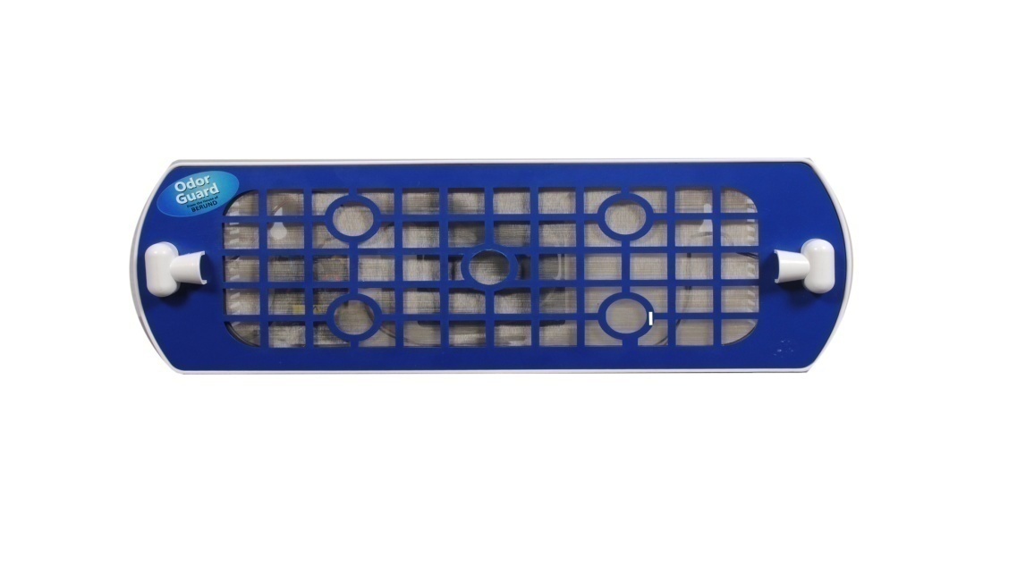
ODOR GUARD
Odor Removing Device
with Nano Technology Screen

Slide 2

Index
What is smell / odor ?
Is your Living Space Healthy?
3. What is Photo-catalysis ?
4. What is Titanium dioxide ?
5. What is nanotechnology ?
6. Why does my toilet / room / vehicle smell ?
7. How does ODOR GUARD work ?
Why ODOR GUARD ?
Applications of ODOR GUARD
10. Benefits of using ODOR GUARD

Slide 3

What is Odor?
Caused by one or more volatilized Chemical Compounds, generally at a very low concentration, that humans or other animals perceive by the sense of Olfaction.
Commonly called scents
Can be pleasant and unpleasant
Primarily used by the food and cosmetic industry to describe a pleasant odor, and are sometimes used to refer to Perfumes
Malodor, stench, reek, and stink are used specifically to describe unpleasant odor.

Slide 4

Interesting Facts- Odor
Humans have 10 million olfactory receptors and can differentiate 10000 different smells
Dogs have 200 million olfactory receptors receptors and can differentiate 40000 different smell
Measured in PPM (Parts per Million)
Bad odor are between 5 and 50 PPM.
Hydrogen Sulphide ( rotten egg smell ) can be sensed at 1-5 PPM, cause respiratory problems at 100 ppm and death at around 1000 ppm.
Ammonia which is responsible for Urine smell can be sensed at 1 ppm.

Slide 5

Is your Living Space Healthy? No!
Artificial Room Fresheners
Toilet Smell (Ammonia)
Cigarette smoke
Mold
Artificial Car Fresheners
Perfumes
Pet Odor
Pollution
Air-borne irritants
Foul leather smell

Slide 6
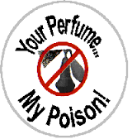
Why not Artificial Room Fresheners?
Carcinogenic
Causes Neurological Damage
Reproductive and Developmental Disorders
Component | Hazard
Acetone | Gastrointestinal Toxin
Butane & Iso-Butane | Nervous System Toxin
LPG | Flammable
Propane | Cardio
Perfume | 95% of Petroleum Products
Benzene | Leukemia
Formaldehyde | Carcinogenic

Slide 7
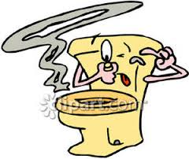
Toilet Smell due to Ammonia
High exposure causes
  Headache
  Nausea
  Intense Burning of Eyes, Skin and Throat
Triggers Asthmatic attacks
Triggers Emphysema attacks

Slide 8
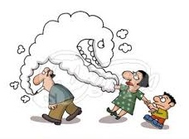
Cigarette smell
Cancer
Affects lungs and Breathing.
Heart and blood vessels are effected.
Increases risk of osteoporosis.
Vision affected.

Slide 9
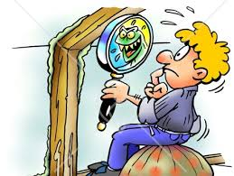
Mold and Dampness
Upper Respiratory Tract Infection (Institute of Medicine - 2004)
Cough and Wheezing
Triggers Asthmatic Attacks
Reduces Immunity in Hypersensitivity Pneumonitic Patients

Slide 10
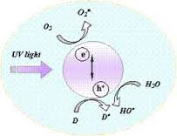
What is Photo-catalysis?
Natural process in which hits a mineral and triggers a chemical reaction that decomposes organic matter
Opposite of Photosynthesis
UV-PCO (ultraviolet photo-catalytic oxidation) technology was discovered over thirty years ago in Japan

Slide 11

Functions of Photo-catalysis?
UV Photo-catalytic Oxidation
Sterilizing Effect /Bacteria reduction
Deodorizing
Air Purifying
Anti fogging
Self-Cleaning
Water Purification
Elimination of Toxic and Carcinogen gases

Slide 12
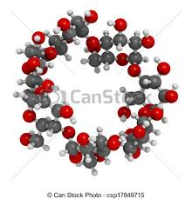
Deodorizing Effect
On the deodorizing application, the hydroxyl radicals accelerate the breakdown of any Volatile Organic Compounds or VOCs by destroying the molecular bonds. This will help combine the organic gases to form a single molecule that is not harmful to humans thus enhance the air cleaning efficiency. Some of the examples of odor molecules are: Tobacco odor, formaldehyde, nitrogen dioxide, urine and fecal odor, gasoline, and many other hydro carbon molecules in the atmosphere.
Air purifier with Ti02 can prevent smoke and soil, pollen, bacteria, virus and harmful gas as well as seize the free bacteria in the air by filtering percentage of 99.9% with the help of the highly oxidizing effect of photo-catalyst (Ti02).

Slide 13

Sterilizing Effect / Bacteria reduction
Photo-catalyst does not only kill bacteria cells, but also decompose the cell itself. The titanium dioxide photo-catalyst has been found to be more effective than any other antibacterial agent, because the photo-catalytic reaction works even when there are cells covering the surface and while the bacteria are actively propagating. The end toxin produced at the death of cell is also expected to be decomposed by photo-catalytic action. Titanium dioxide does not deteriorate and it shows a long-term anti-bacterial effect. Generally speaking, disinfections by titanium dioxide is three times better than chlorine, and 1.5 times better than ozone

Slide 14

Air Purifying Effect
The photo-catalytic reactivity of titanium oxides can be applied for the reduction or elimination of polluted compounds in air such as NOx, cigarette smoke, as well as volatile compounds arising from various construction materials. Also, high photo-catalytic reactivity can be applied to protect lamp-houses and walls in tunneling, as well as to prevent white tents from becoming sooty and dark. Atmospheric constituents such as chlorofluorocarbons (CFCs) and CFC substitutes, greenhouse gases, and nitrogenous and sulfurous compounds undergo photochemical reactions either directly or indirectly in the presence of sunlight. In a polluted area, these pollutants can eventually be removed

Slide 15
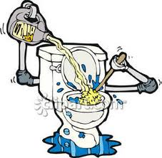
Anti fogging, Self-Cleaning
Most of the exterior walls of buildings become soiled from automotive exhaust fumes, which contain oily components. When the original building materials are coated with a photo-catalyst, a protective film of titanium provides the self-cleaning building by becoming antistatic, super oxidative, and hydrophilic. The hydrocarbon from automotive exhaust is oxidized and the dirt on the walls washes away with rainfall, keeping the building exterior clean at all times.

Slide 16

Water Purification
Photo-catalyst coupled with UV lights can oxidize organic pollutants into nontoxic materials, such as CO2 and water and can disinfect certain bacteria. This technology is very effective at removing further hazardous organic compounds (TOCs) and at killing a variety of bacteria and some viruses in the secondary wastewater treatment. Pilot projects demonstrated that photo-catalytic detoxification systems could effectively kill fecal coli form bacteria in secondary wastewater treatment

Slide 17

What is Nanotechnology?
Nanotechnology ("nanotech") is the manipulation of matter with at least one dimension sized from 1 to 100 nanometers on an atomic, molecular, and supramolecular scale. A Nano particle is 1/1000 of an atom or 10 to the power of minus 9 of a meter
Titanium dioxide, in thin film and nanoparticle form has potential for use as a photo-catalyst.It can carry out hydrolysis; i.e., break water into hydrogen and oxygen.
Industrial and medical uses
TiO₂ nanoparticles are FDA approved and are widely used in cosmetics, sunscreens, household products, surface coatings (e.g. paint and printing ink) and plastics.

Slide 18

Titanium Dioxide? (TiO2)
Common Earth Mineral
UV Photo-catalytic Oxidation
Sterilizing Effect /Bacteria reduction
Deodorizing
Air Purifying
Anti fogging
Self-Cleaning
Water Purification
Elimination of Toxic and Carcinogen gases

Slide 19
How it work ?
Light
Light
Light
VOC & Odor
Bacteria
Fungus
Germs
TiO2 PHOTOCATALYTIC REACTION
Deodorization
Air Purification
Water Purification
Sterilization

Slide 20

Why Odor Guard?
Environmentally Friendly
No Toxic and Carcinogenic gases
Odor Eliminating
Anti Polluting & Eco Friendly
Anti Bacterial
Anti Viral
Self Cleaning
Long Lasting
Ultra Violet Photo-catalytic Oxidation (UVPCO)

Slide 21

How does ODOR GUARD work ?
A photo-catalytic reaction occurs when UV light, either natural (the sun) or artificial (fluorescent or black light bulbs) reacts with a material that contains certain forms of titanium dioxide to create oxidizing agents (hydroxyl radicals) that decompose (breakup) all organic materials. The photo-catalytic reaction converts organic matter (oils, biofilm, grime, mold, micro-toxins) to water and trace amounts of carbon dioxide.
TI02 coatings are clear, colorless, environmentally friendly water-based suspensions of Nano-sized particles of photoactive TI02 (titanium dioxide – a common earth mineral). The coating consists of a 1% solution (in liquid form) with a pH level of between 7.0 and 7.5 (neutral) and a VOC level of 0% when cured. The screen is made from a stainless steel mesh surrounded by a plastic frame. The finished screen surface is inert and does not off gas or degrade under any normal conditions. There are no chemicals or surface residues that will erode or flake off.

Slide 22
How does ODOR GUARD work ? Cont…
The TI02 material is already coated on the screen and ready to use immediately. The screen surface is a Nano particle-bonded, ultra thin mineral film layer that is highly durable, self-cleaning, odor killing and germ resisting. The product is used both in autos as well as interior living and working spaces.
There is no power needed, no special handling required, no UV light is needed, only closed interior space ,minimal air circulation and the screen does the rest.
For non silver odor guard screens, only 0.00005 lumen ( moonlight gives 0.2 lumen) is required to keep the screen activated.
Activation is simple and anyone can do it.

Slide 23

Applications of ODOR GUARD
Removes a wide realm of odors like Volatile Organic Compounds (VOCs)
Removes organic odors such as odors from Toilets, cooking, pets, mold, body and more
Versatile and competitively priced
Its uses are for AUTO,TRAINS,PLANES or MOBILE HOME,TRUCK, in your HOMES or to take on the road. It’s versatility and price is making it the hottest product on the market.

Slide 24
Applications of ODOR GUARD- Contd..
Not only is it very affordable and can remove odors, but it can also be placed anywhere
  BATHROOMS
  VEHICLES
  KITCHENS
  OFFICES
  HOTELS
  HOSPITALS
  SHOPS
  THEATRES
  SCHOOLS
  RESTAURANTS
  SHOE RACKS.

Slide 25

Pre-Requisites for Installation
Closed Environment.
Minimal Air Movement.
Good exposure to light (not required for silver screen and suction box ).
Effective area of Coverage 200-500sqft. ( depends on no. of people).
Initial activation before installation, by exposing the screen to the Sun for 30 seconds. ( not required for silver screen).
Fix ODOR GUARD using suction cup or with screws or just hang it on a nail.

Slide 26
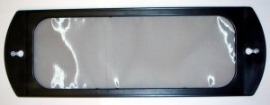
Features- Odor Guard
Patented Titanium Dioxide and Silver Screen (U.S)
Suspended Nano Particles
Clear, Colorless and Odorless
Modeled in 4”x12” Plastic Frames
Customizable Installation
Self Activating (Silver Coating)
Eco-Friendly Manufacturing (U.S)

Slide 27

Benefits of using ODOR GUARD -
1. ODOR ELIMINATING EFFICACY ( KILLS SOURCE )
2. ANTI POLLUTION EFFICACY
3. ANTI BACTERIAL & ANTI VIRAL EFFICACY
4. ELIMINATES MOLD AND MILDEW
5. SIMPLE TO INSTALL & USE
6. WORKS 24/7
7. NO MECHANICAL COMPONENTS TO REPLACE
8. LONG LIFESPAN ( 1 YEAR )
9. ECONOMICAL

Slide 28
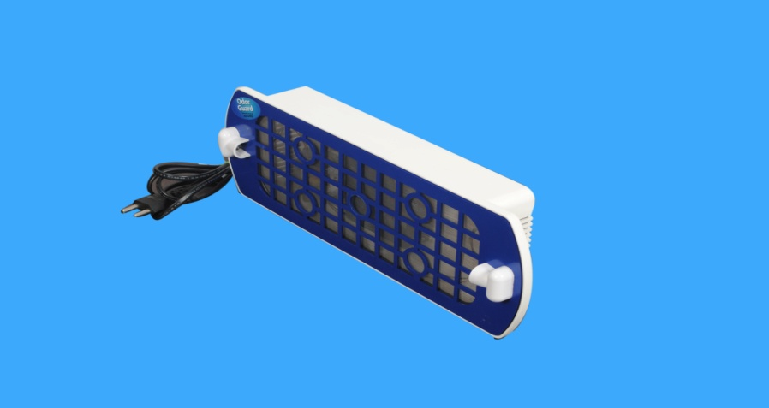
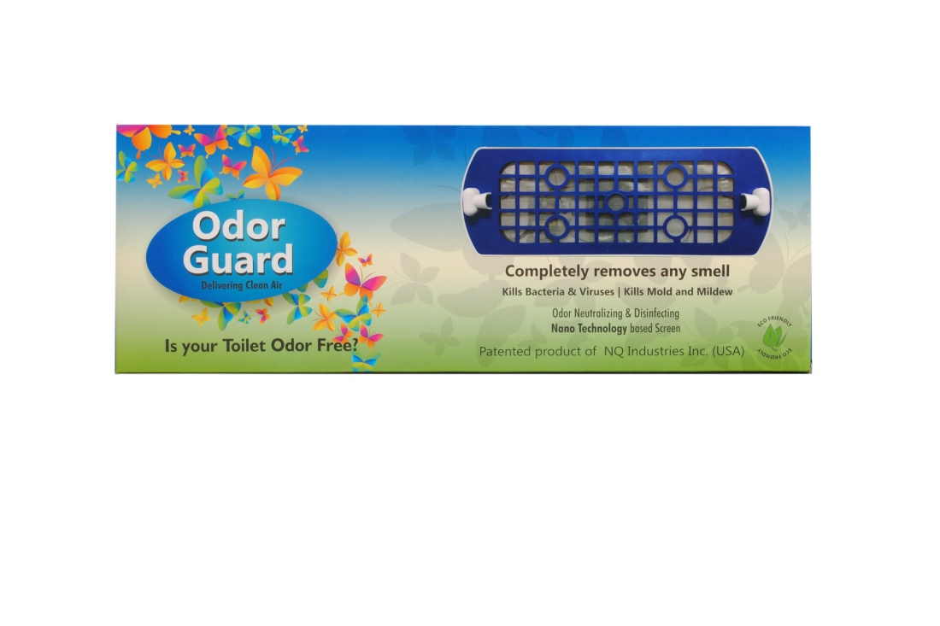
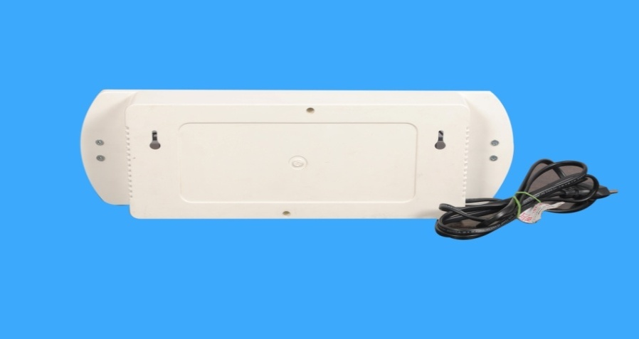
Variant of Odor Guard – for Toilets

Slide 29
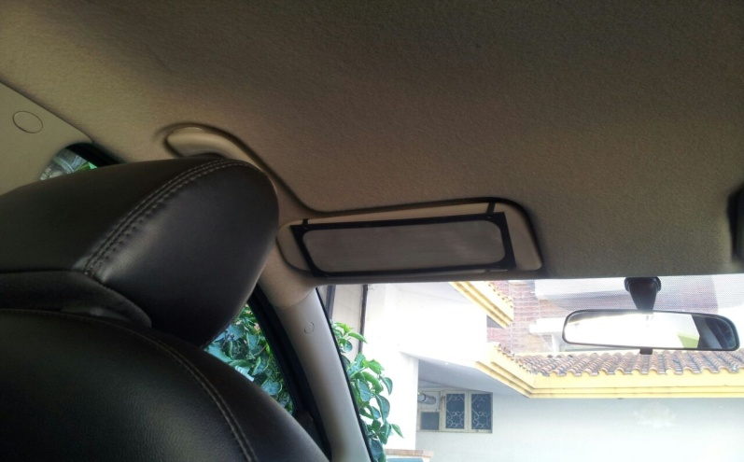
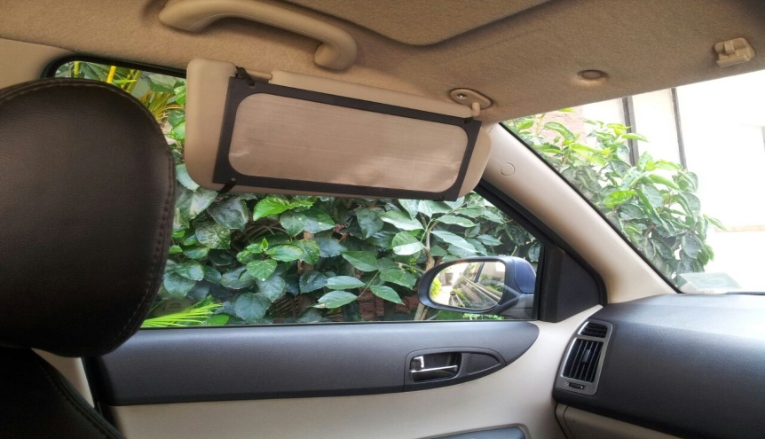
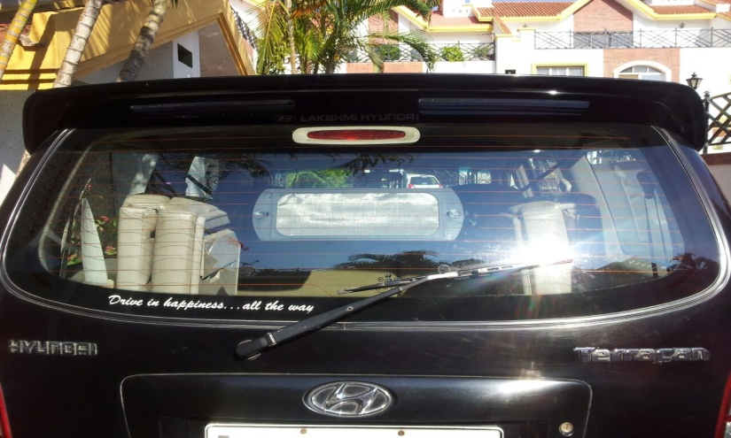
Variant of Odor Guard – for Cars

Slide 30
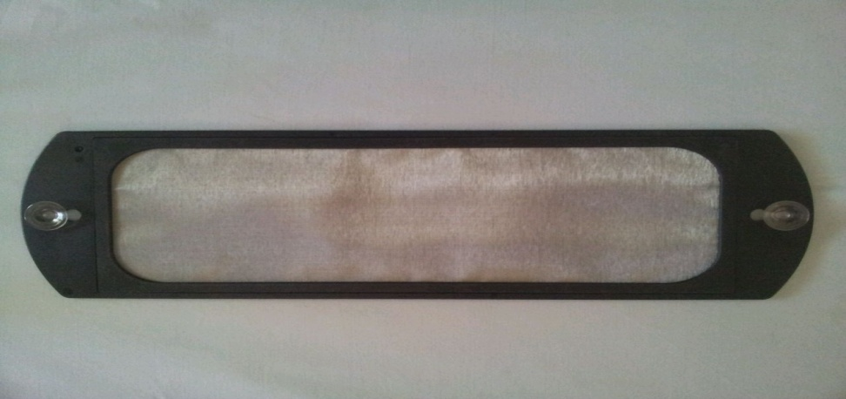
Variants of Odor Guard Screens
Self activating Silver Screen –
( light source not required )
Screen with Suction Cups – multiple applications
Screen with Elastic bands – for cars

Slide 31


